Slide 1
Travelers Case Competition
Presentation
Team: UConn Machine learners
Ashish Kumar Doke
Ajay babu addagadda
Bhaskar surender pothula
Rahul kumar Thatikonda

Slide 2
Agenda
Data Sampling
Data Pre-Processing and Feature engineering
Data Modeling
Model Evaluation and Implementation
Questions about data
Recommendations

Slide 3
Data Sampling:
The data with 9990 (Train +Test) observations and 18 variables (17+1) was split in a 70:30 for training and validation.
Data Pre-Processing:
Missing values :
Outlier Detection and Treatment:
Feature Engineering:
Introduced Credit_Age_category, State, Std_Premium_per_Age, Std_Age_Residence, Std_Tenure_Residence.

Slide 4
Data Modeling: Variable Selection
Eliminated Continuous variables which exhibited correlation
Tested Categorical features Independence by Chi-Square test for selection
Stepwise Regression to narrow down your search by using regularisation with cross-validation and tallied with random forests
Leveraged Gradient boosting classifier ensemble to test Single feature effect on the Metric(AUC)
Optimised the search for Group of predictors and their combinations to build the model to come up with the best features.
Variables Selected: Total_members, Std_Premium_age, Std_age_residence, Std_tenure_residence, Claim_ind, Credit, Credit_age_category, Sales_channel and Marital_status

Slide 5
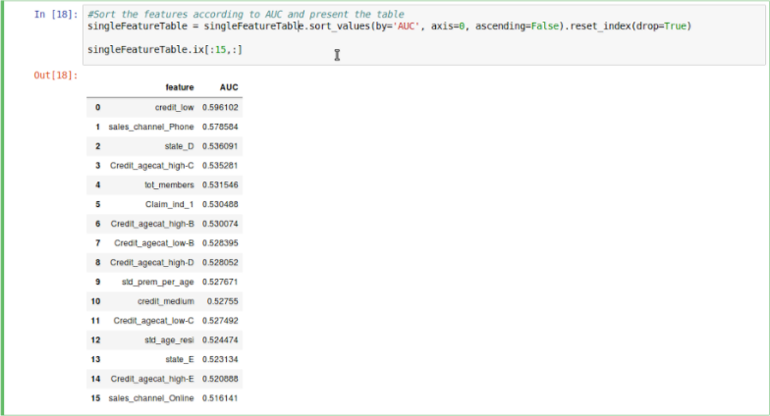
Individual feature importance

Slide 6
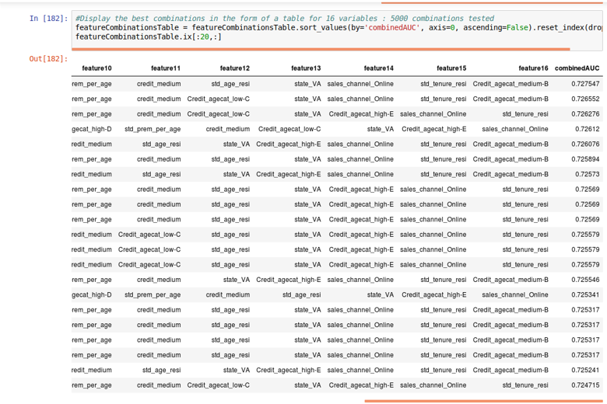
Best combination of features by AUC metric

Slide 7
How did you test the assumptions of this method?
Assumptions of logistic regression:
Dependent variable to be binary and ordinal:
Value ordered the dependent variable ( Cancel) category to represent the desired outcome.
Test of model fit:
Used K-fold cross validation to eliminate overfitting and underfitting of the model by including only meaningful variables by stepwise regression search and xgboost classifier

Slide 8
Algorithms Implemented: Metric: AUC
Model | Raw Data | Processed Data
Logistic Regression | 0.63 | 0.68
Random Forest | 0.57 | 0.62

Slide 9
Model Selection: After Feature Selection
K-fold Cross validation (k=10)
Model | AUC | Recall | Precision
Logistic | 0.725 | 0.62 | 0.45
Random Forest | 0.707 | 0.34 | 0.48
Logistic Regression with L2 regularization | 0.730 | -- | --

Slide 10
What variables help explain retention rate?
Customers with ‘high’ credit and ‘60+’ age have odds ratio of (0.0419).
Customers who bought policy through ‘Broker’ have odds ratio of (-4.17).
Customers who are unmarried have odds ratio of (-0.66).
These customers have highest retention rate when compared to other categories.

Slide 11
What questions do you have about the data?
When did the customer cancel and/or claim i.e., the exact date and time of the year?
What is the worth of claim?
What is the nature of claim?
History (Count) of claims made by individual customer?
What is the current condition of the house?
Additional data around customer demographics information (occupation, education level) and survey results showing the results of claim and/or cancel would help better analyse the reasons behind them.

Slide 12
Business Recommendations
Data from the table shows that customers living in ‘Condo’ and ‘House’ with ‘high’ credit in age group ‘30-39’ are with the same policy. But, customers who are ‘Tenants’ with ‘high’ credit in age group ’30-39’ are cancelling their policies.
Coverage Type | Dwelling Type | Credit | Age | Cancel % (No)(0) | Cancel % (Yes)(1) | Count of records
A | Condo | High | 30-39 | 89.25% | 10.75% | 121
B | House | High | 30-39 | 86.67% | 13.33% | 105
A | Tenant | High | 40-49 | 86.29% | 13.71% | 124
Coverage Type | Dwelling Type | Credit | Age | Cancel % (No)(0) | Cancel % (Yes)(1) | Count of records
C | House | Medium | 50-59 | 74.76% | 25.24% | 103
B | House | High | 40-49 | 76.54% | 23.46% | 179
A | Tenant | High | 30-39 | 76.86% | 23.14% | 108
%calculations are based on total of its own category.
Inference: Customers face issues transferring their address in their policies.
Recommendation: Better customer service must be provided to resolve their issue. Predicting those customers who change their address frequently must be identified and better premium rates must be offered based on location and other demographics.

Slide 13


